Slide 1
Power-CONSUMPTION
DEPI Graduation Project:

Slide 2
Team Member:
Asmaa Hamdy Abdelaleem
Fatma Ayoub Ahmed
Salma Mahdy Mohamed

Slide 3
AGENDA
Project Overview
1
Introduction
2
Data Source
3
Data Engineering Workflow
4
Azure
5

Slide 4
AGENDA
Machine Learning Pipeline
6
Data Analysis
7
Tools & Technologies
8
Reporting with Power BI
9
Conclusion
10

Slide 5
Project Overview

Slide 6
Project Overview
Purpose:To analyze household energy usage patterns and predict power consumption using machine learning.
Objective:Build a system to process large-scale energy data, clean and transform it, perform feature engineering, and train a predictive model.
Outcome:Developed a scalable pipeline for energy data analysis and achieved high prediction accuracy using linear regression.
Technologies Used:Python, PostgreSQL, SQLAlchemy, Microsoft SSIS, MySQL.

Slide 7
Introduction

Slide 8
Introduction
Dataset: Large dataset containing household power consumption data.
Challenges:Handling large volumes of data, ensuring data quality, and selecting the right model for prediction.
Importance:Helps monitor and predict power consumption, enabling smarter energy use and reducing costs.
Goal:Predict house power energy consumption accurately based on historical data.

Slide 9
Data Source

Slide 10
Data Source
Source Files: Three Excel files containing:
-Voltage Dataset: Contains voltage readings across time.
-Power Dataset: Contains global active and reactive power readings.
-Sub-Metering Dataset: Contains readings from different household
Sub-Meters
Conversion:
-Data was converted from Excel to CSV format using Python for
compatibility and ease of processing
Initial Challenges:
- Excel file format, large file size, inconsistencies in time and date formats.

Slide 11
Data Engineering Workflow

Slide 12
Data Engineering Workflow
Data Extraction:
1-Extracted data from CSV files into Pandas DataFrames.
2- Verified data integrity and ensured all files were properly loaded.
Data Cleaning:
1- Time Column Conversion: Converted the Time column in the voltage dataset to a proper datetime format using a lambda function.
2-Handling Missing Data: Checked for missing or null values and either filled or dropped them based on relevance

Slide 13
Data Engineering Workflow
Transformation:
1- Renamed columns to include measurement units (Global_Active_Power_KW) to maintain consistency.
2- Transformation : Created a new column(Apparent_Power_KVA) using the formula:

Slide 14
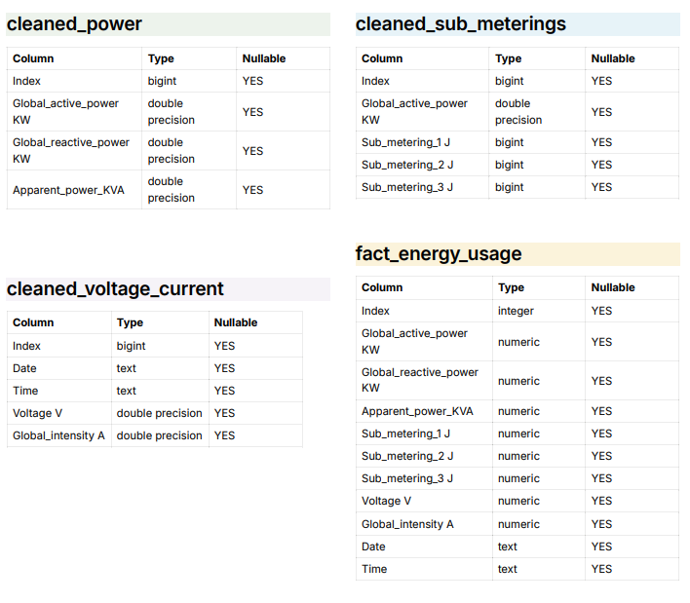
Data Engineering Workflow
Data Warehouse by Postgras

Slide 15
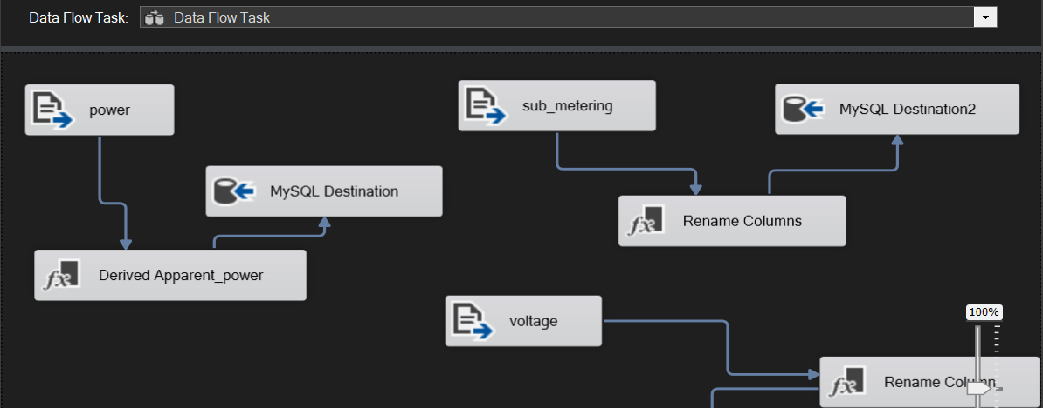
Data Engineering Workflow
ETL package using SSIS integration tool

Slide 16
Azure

Slide 17
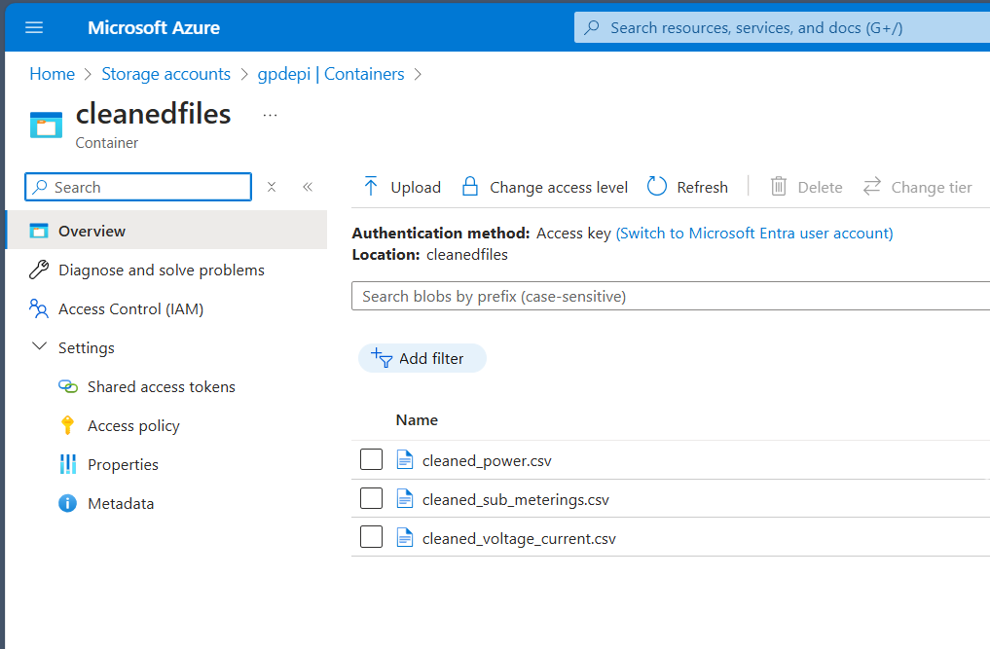
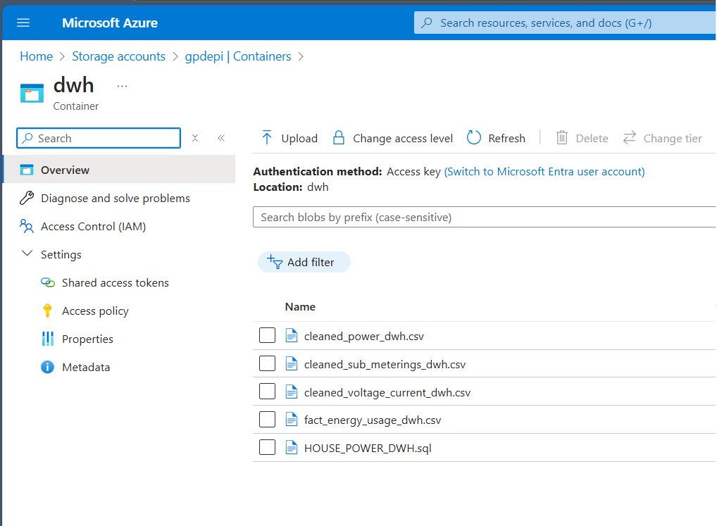
Azure
Our first step in the Azure project
was data storage.
where we added datasets and
stored our data warehouse (DWH).

Slide 18
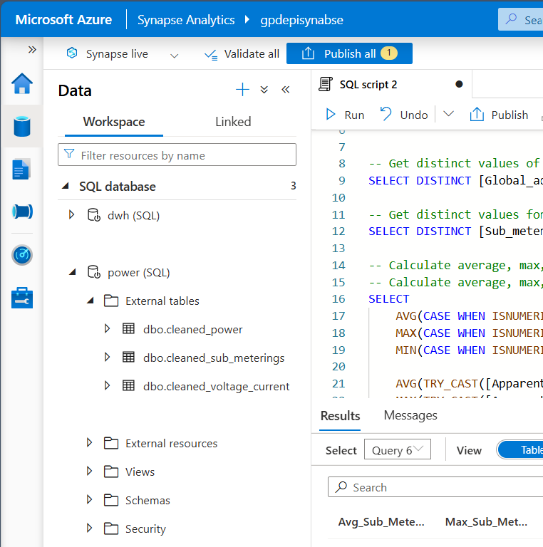
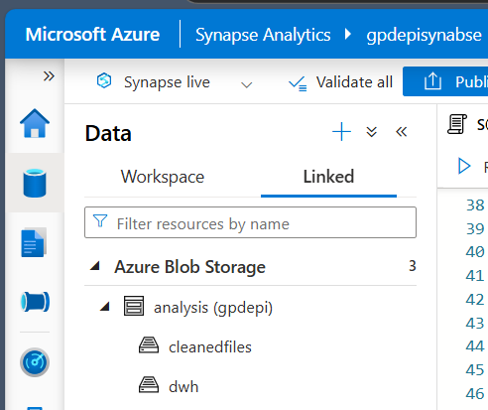
Azure
"Our second step in the Azure project was
using Synapse.
We transformed the files we had stored
into a database

Slide 19
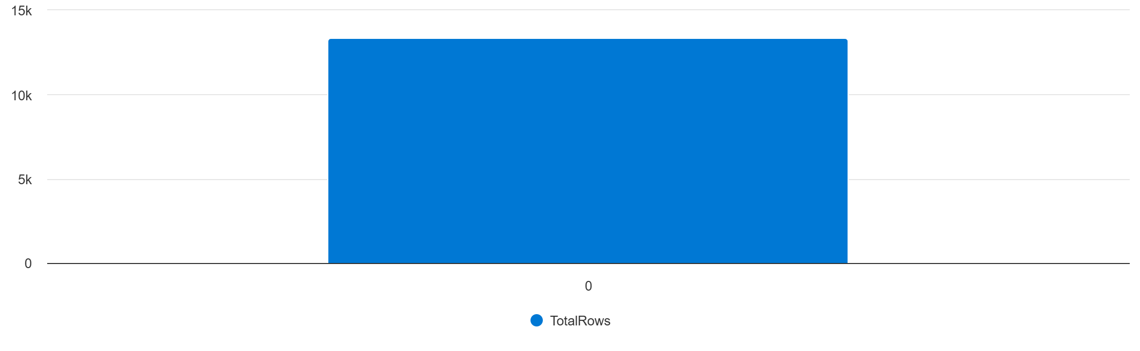
Azure
Some explorations about our data:
The total count of rows that
we used from data sets
is 13357

Slide 20
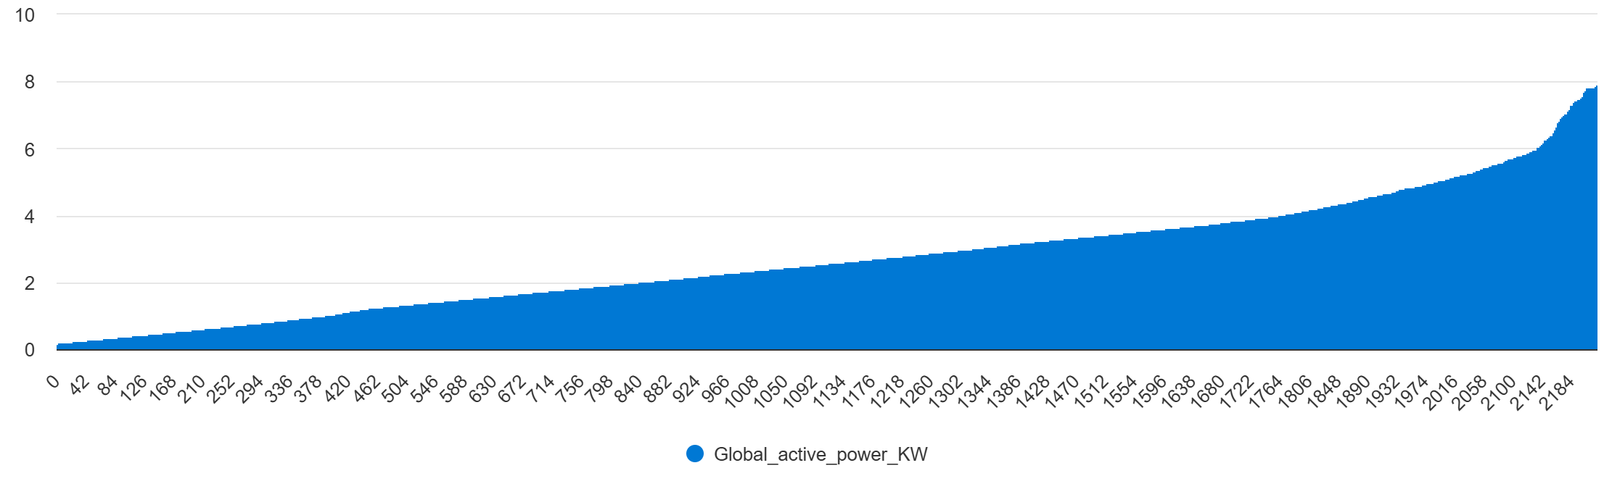

Azure
The first query retrieves distinct
values of active power in kilowatts
while the second query retrieves
distinct energy consumption
values in joules
for sub-metering from

Slide 21
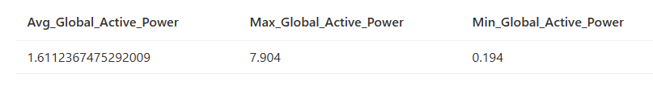
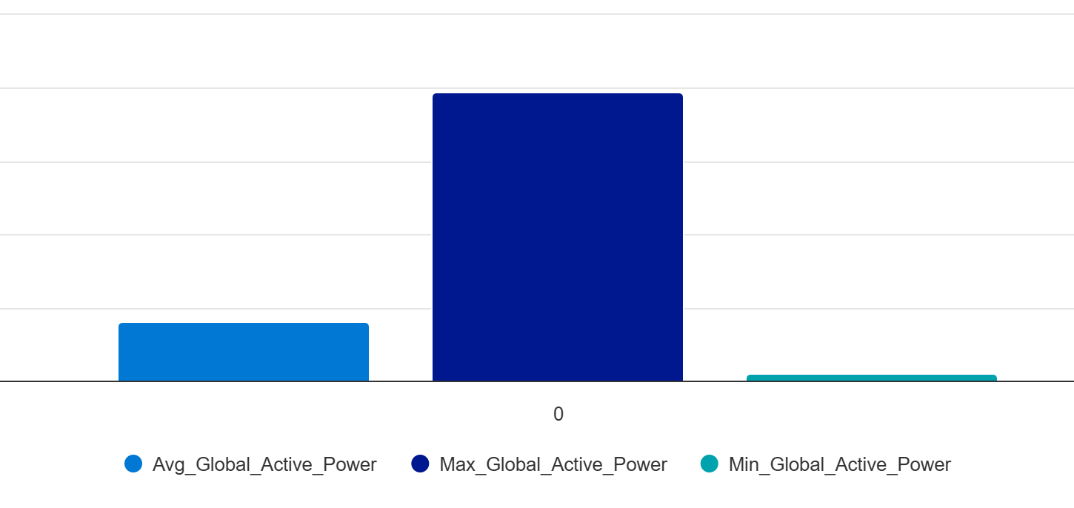
Azure
Here we display the calculation of the
average,maximum, and minimum
values of
Global_active_power_KW

Slide 22
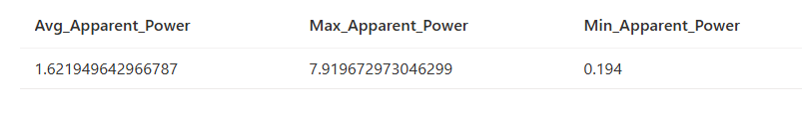

Azure
Here we display the calculation of the
average, maximum, and minimum
values of Apparent_power_KVA

Slide 23
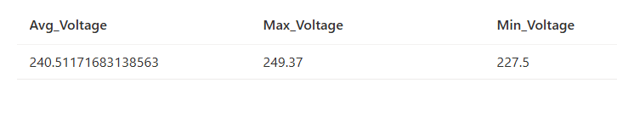
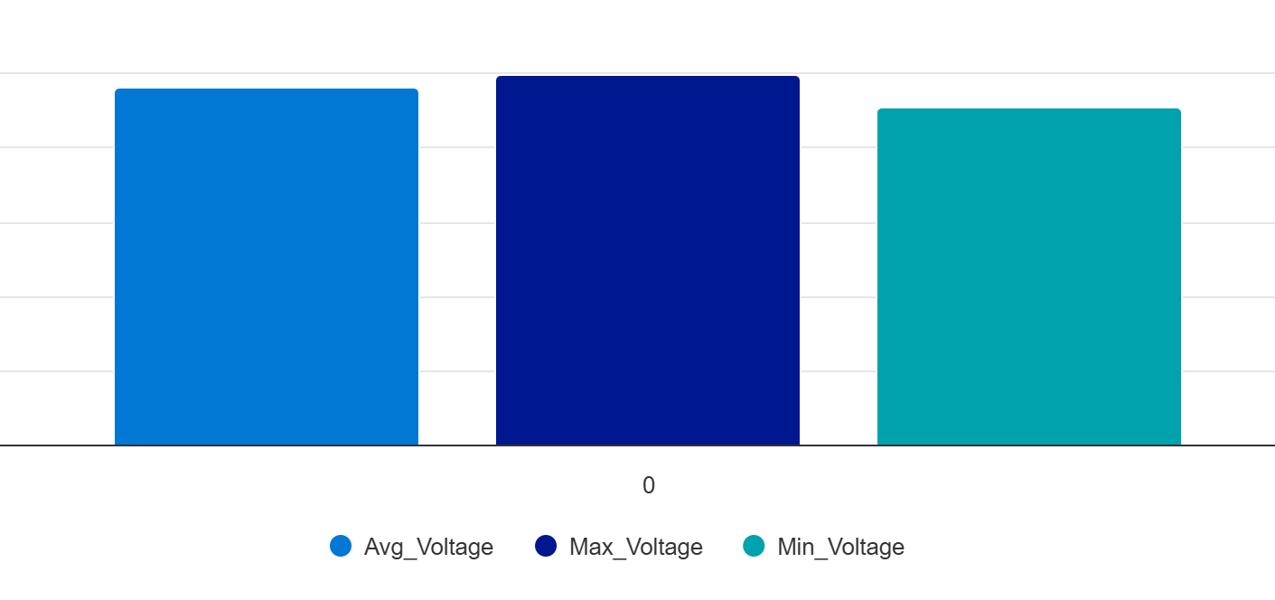
Azure
Here we display the calculation of the
average, maximum, and minimum
values of Voltage_V.

Slide 24
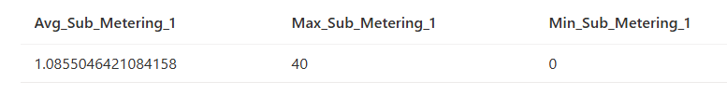
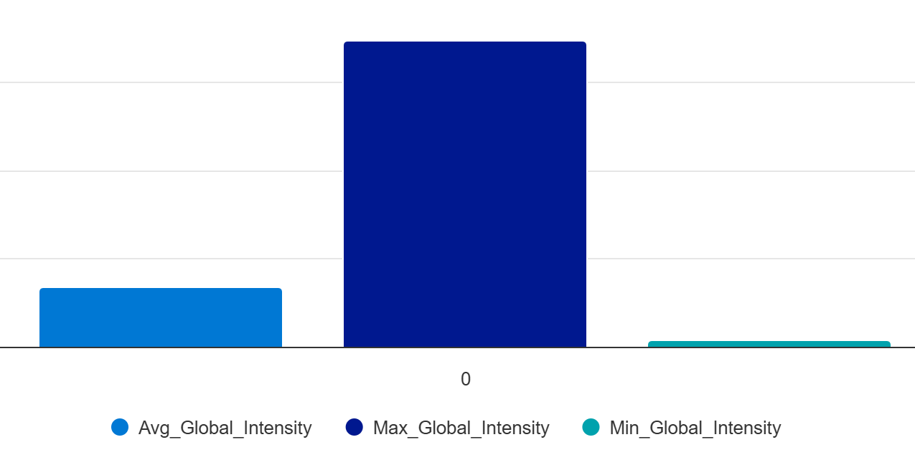
Azure
Here we display the calculation of the
average, maximum, and minimum
values of Global_intensity_A.

Slide 25
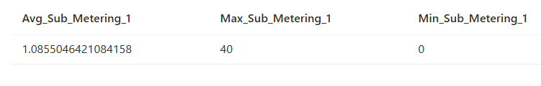
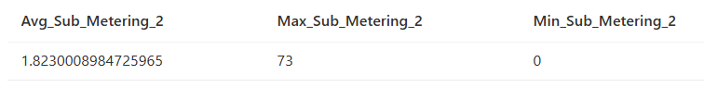
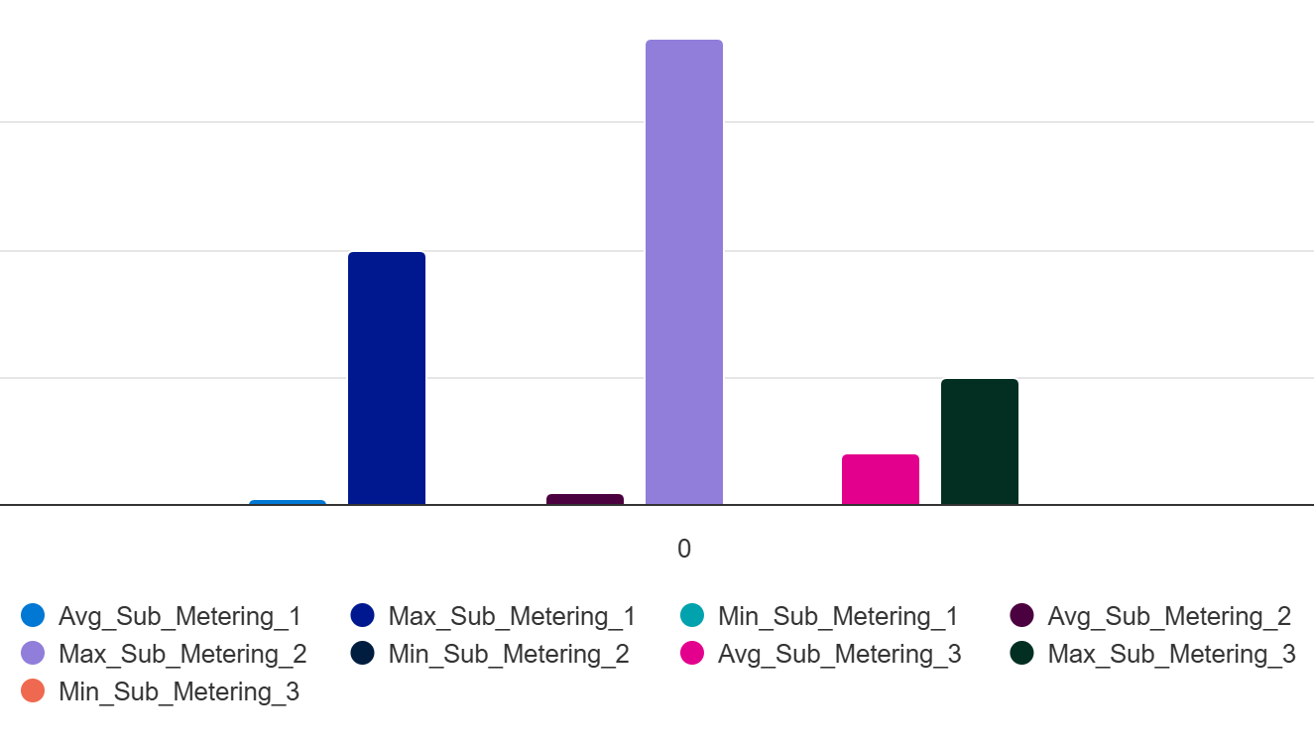
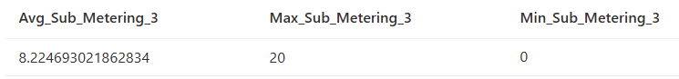
Azure
Here we display the calculation of the
average, maximum, and minimum
values for Sub_metering_1_J,
Sub_metering_2_J,
and Sub_metering_3_J.

Slide 26
Data Analysis

Slide 27
In your opinion, which of these consumes the most energy: the kitchen, the laundry room, or the water heater and air conditioner?

Slide 28
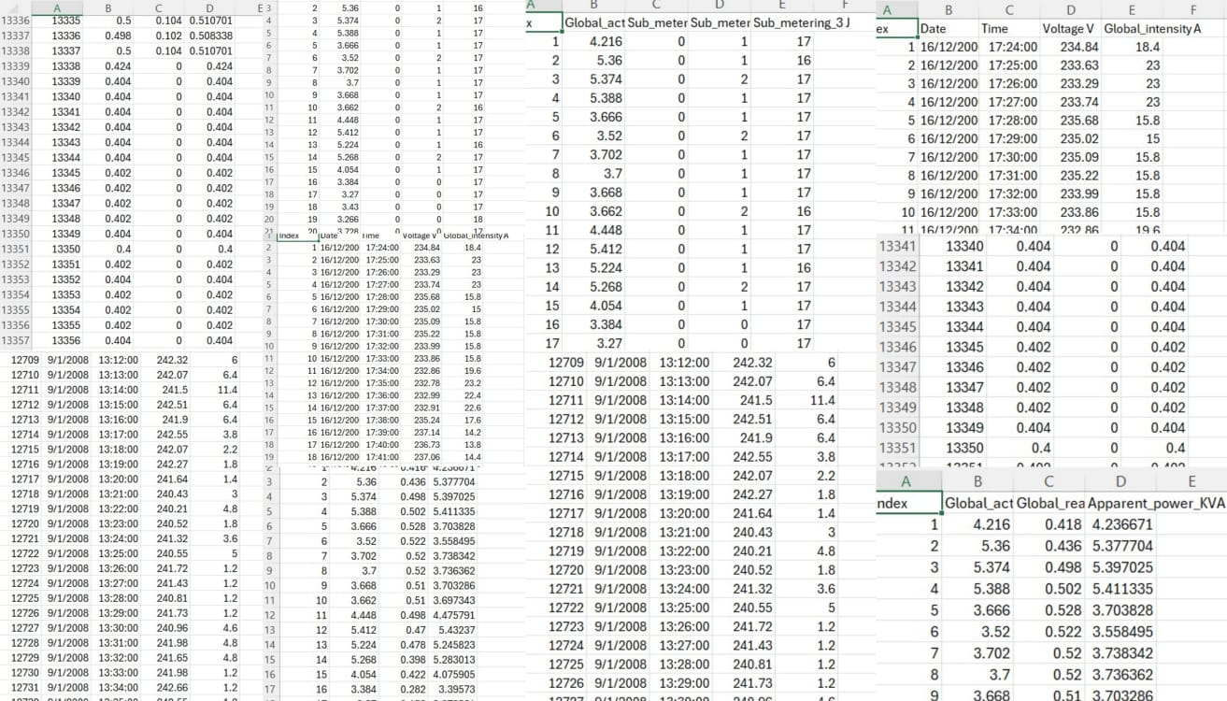

Slide 29
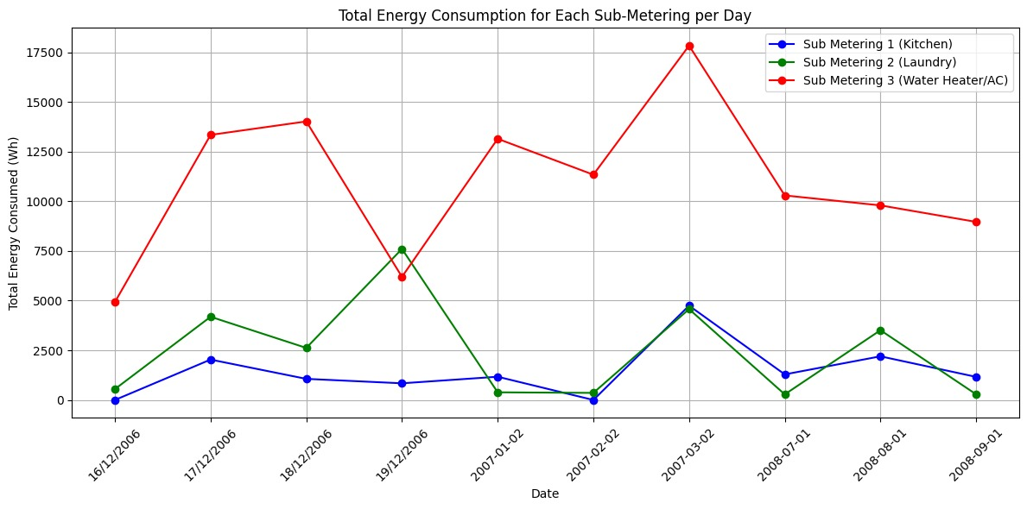
Key Insights
"How much total energy is consumed by each sub-metering per day ?“
-Total energy consumption for three sub-metering systems (Kitchen, Laundry, and Water Heater/AC) and The visualization of thit data using a line plot for each sub-metering.

Slide 30
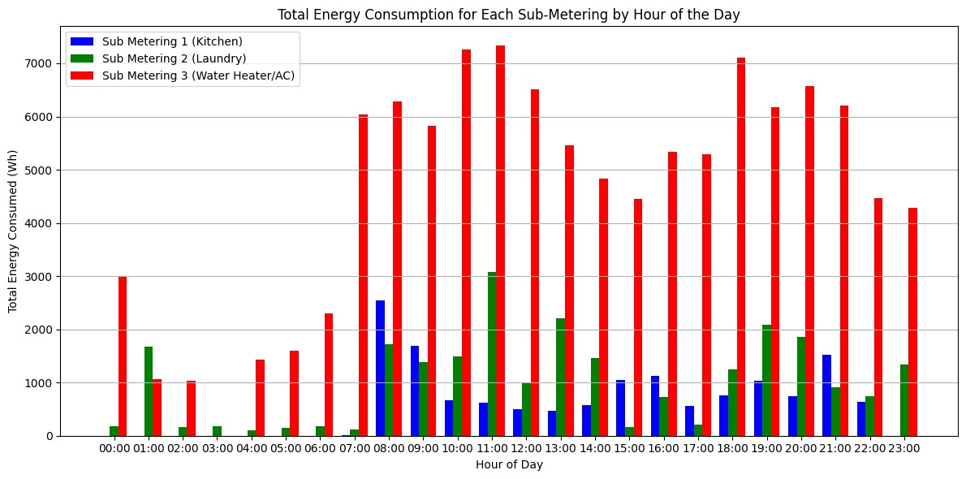
"What is the total energy consumed by each sub-metering system for each hour of the day ?“
-The total energy consumption by hour for three sub-metering systems (Kitchen, Laundry, and Water Heater/AC) and the visualization of the hourly consumption with a grouped bar chart, where each hour of the day shows three bars representing the different sub-metering systems

Slide 31
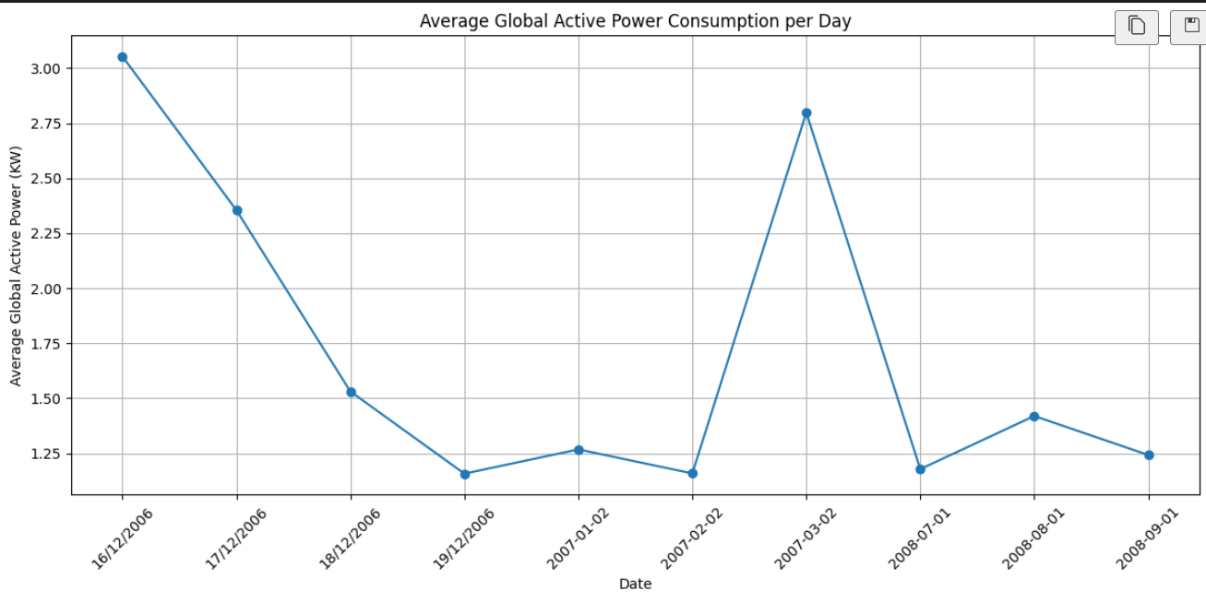
Key Insights
Average Global Active Power Consumption per Day
Calculated the daily average global active power consumption to understand the typical usage pattern

Slide 32
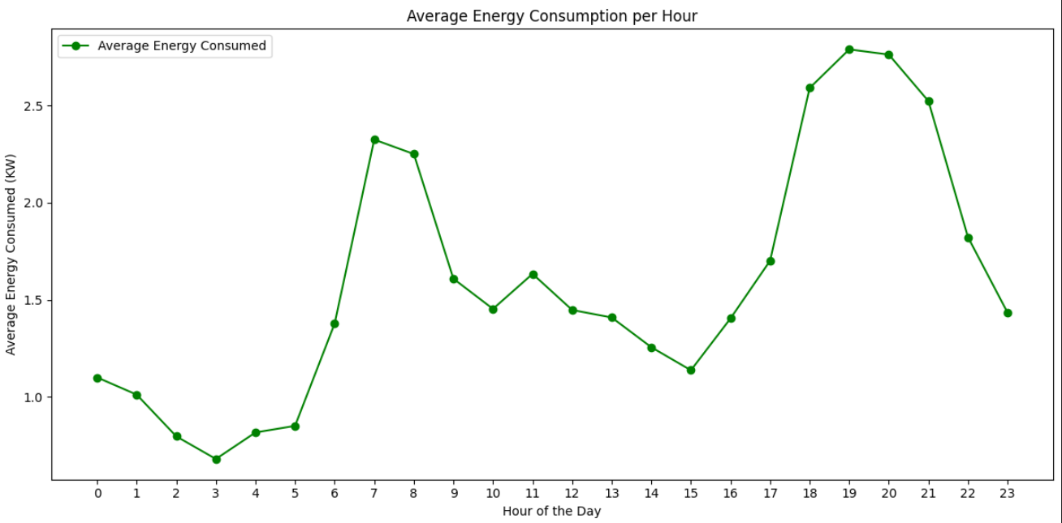
Average Energy Consumption per Hour
Analyzed energy usage on an hourly basis to capture fluctuations throughout the day.

Slide 33
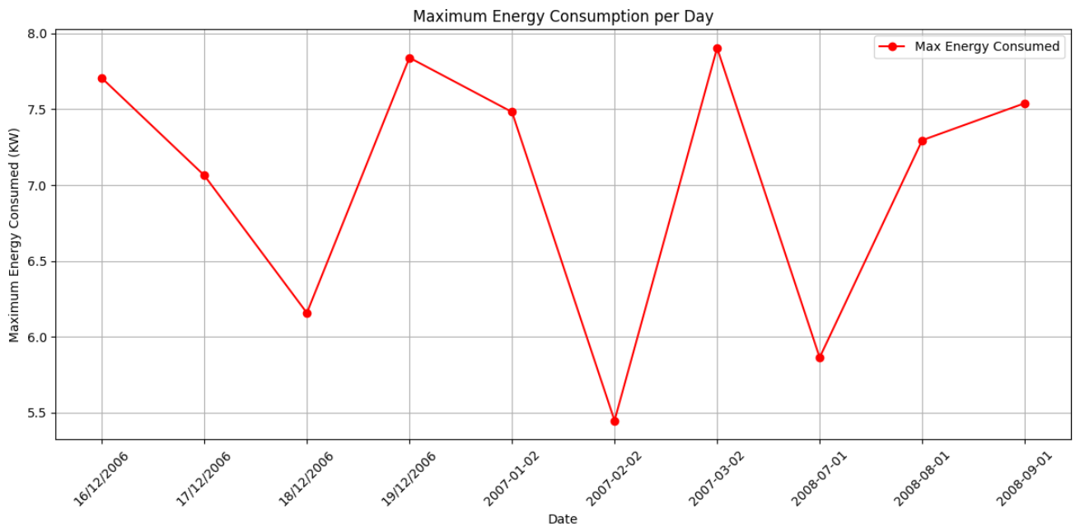
Maximum Energy Consumption Recorded During a Day
Identified peak daily energy consumption to detect spikes

Slide 34
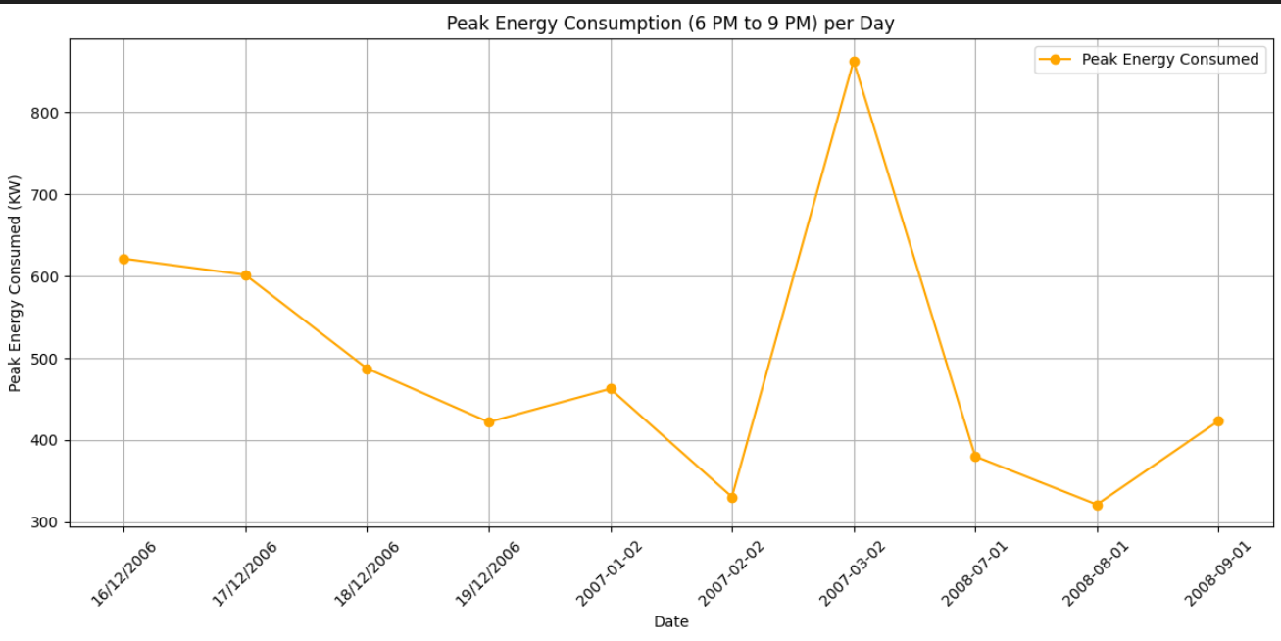
What is the maximum energy consumed each day during peak hours (between 6 PM and 9 PM) ?
-The total energy
consumption during peak evening hours (6 PM to 9 PM) for each day. The plot shows how energy consumption peaks change over time.

Slide 35
MachineLearning Pipeline

Slide 36
Content
Data Preprocessing
Model Selection
Training
Model Evaluation
Visualization

Slide 37
MachineLearning Pipeline
Data Preprocessing:
1- Dropped irrelevant columns like Date and Time to reduce noise
2- Applied MinMaxScaler to scale the feature values between 0 and 1, ensuring equal contribution from all features
Model Selection:
- Chose Linear Regression as it is well- suited for continuous variable prediction and performed well during initial testing

Slide 38
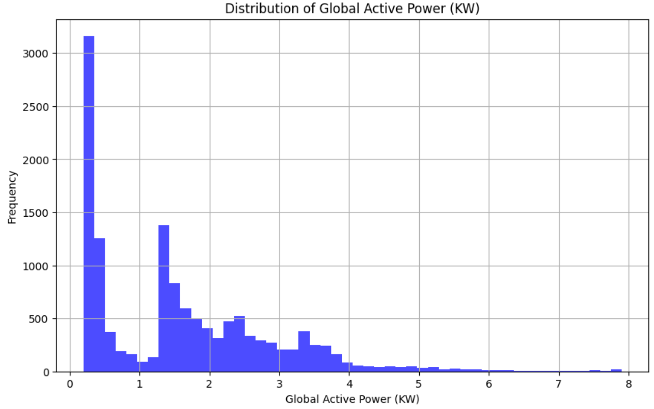
Visualization
The distribution of (Global_active_power KW)

Slide 39
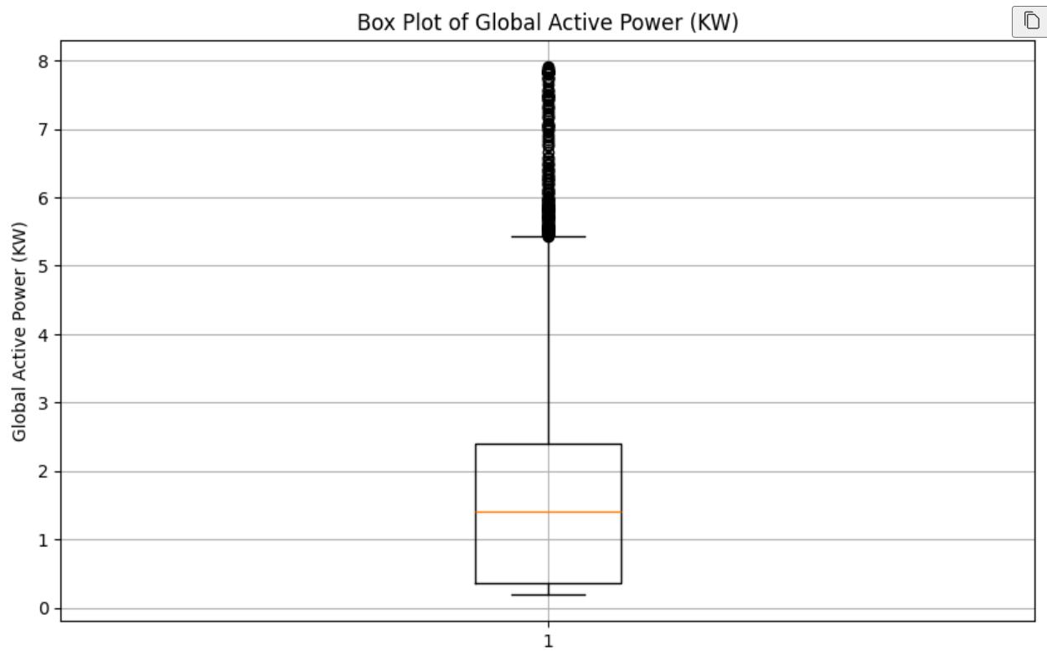
Visualization
outliers in the (Global_active_power KW)

Slide 40
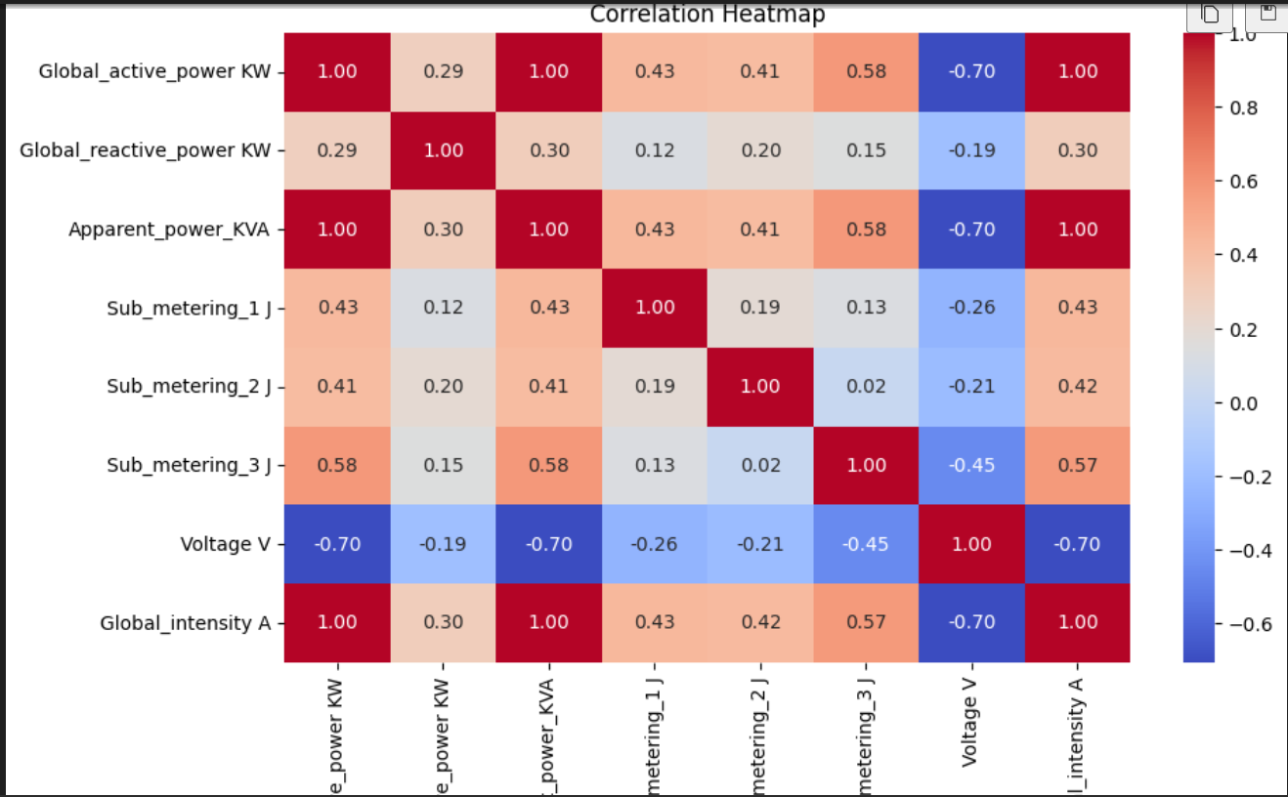
Visualization
The correlation between all numeric variables

Slide 41
Machine Learning Pipeline
Training:
- Splitting the data into training and testing sets to evaluate the model’s performance
- Trained the Linear Regression model using the scaled data
Model Evaluation:
-Evaluated the model using R² Score, which resulted in 99.9% accuracy.
-To prevent overfitting and better assess the model's performance, I used 5-fold Cross- Validation.
- Cross-validation splits the data into 5 folds, each time training on 4 folds and validating on 1.
- The average R² score across the 5 folds was 99.9%, showing that the model performed consistently across different data splits

Slide 42
Tools & Technologies

Slide 43




Tools & Technologies
PYTHON
PostgreSQL
MySQL
Microsoft SSIS

Slide 44
Tools & Technologies
PYTHON:
Primary tool for data extraction, cleaning, transformation, feature engineering, and model building
PostgreSQL:
The data warehouse that stored the cleaned and transformed data. Used for querying and data manipulation.

Slide 45
Tools & Technologies
Microsoft SSIS:
SQL Server Integration Services was used to create an alternative ETL pipeline that mirrors the Python workflow. This was particularly helpful for comparisons and redundancy.
MySQL:
Secondary database used to store the data processed by the SSIS ETL package

Slide 46
Reporting with Power BI

Slide 47
Reporting with Power BI
Purpose
To visualize and present the analysis results effectively using Power BI.
Key Features
Data visualization tools to help understand trends and patterns.
Process
Data imported from CSV to Power BI for visualization
Created various visualizations (e.g., line charts, bar graphs)
Benefits
Data visualization tools to help understand efficiency and patterns.
Helps in making informed decisions based on visual data representation.

Slide 48
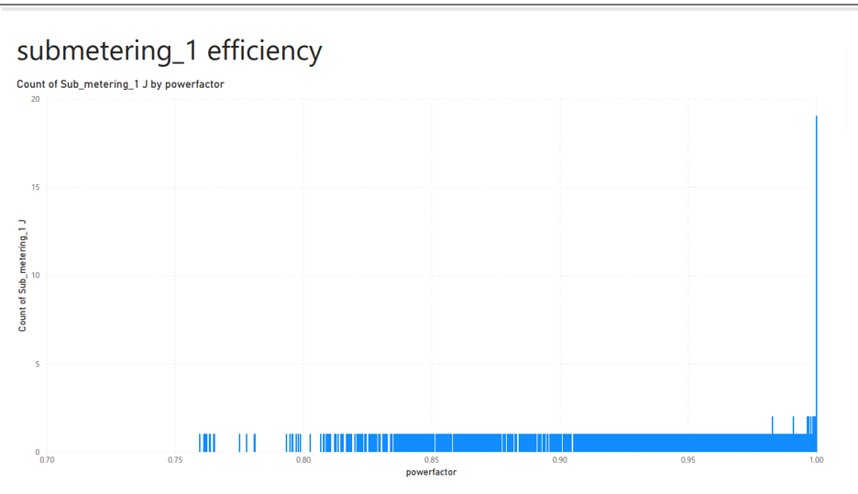
Reporting with Power BI
Submetering_1 efficiency
The graph shows the count of energy usage (kitchen)in joules (J) across power factors. The power factor ranges from 0.7 to 1.0 on the x-axis, and the y-axis shows the count of readings. The data peaks around a power factor of 0.85.

Slide 49
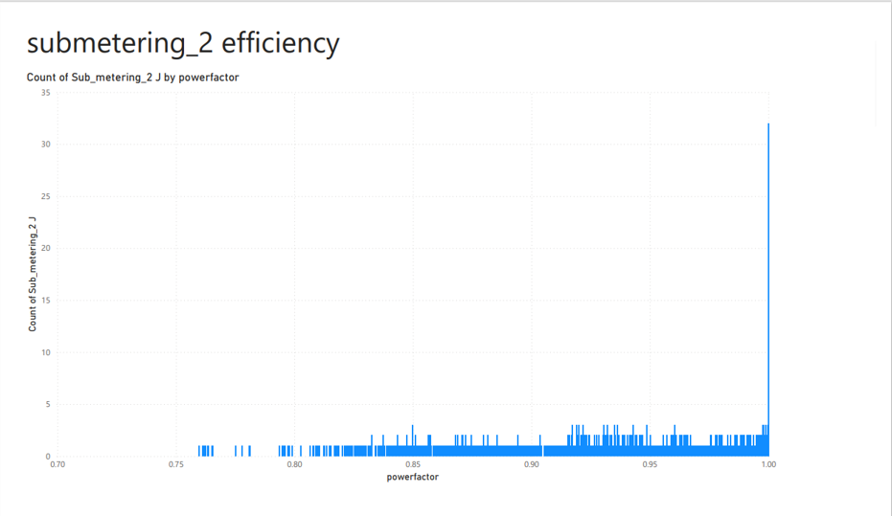
Reporting with Power BI
Submetering_2 efficiency
This chart visualizes the count of energy usage (laundry room) in joules (J) by power factor. The x-axis ranges from 0.7 to 1.0, and the y-axis represents the count of Sub_metering_2 readings. It displays higher counts compared to Sub_metering_3, with a peak around a power factor of 0.9.

Slide 50
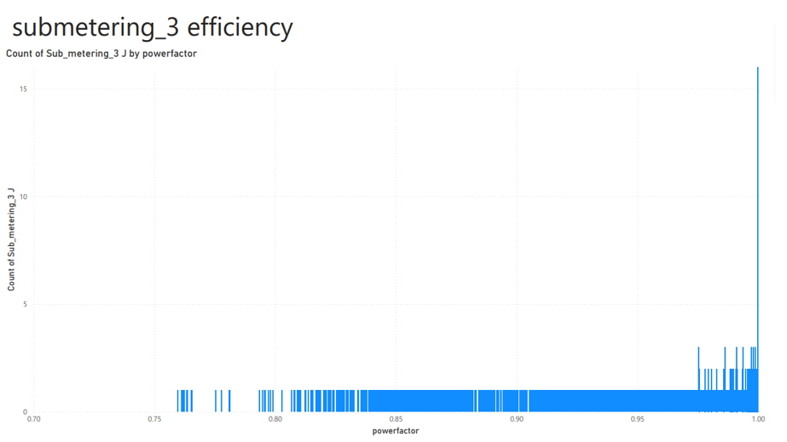
Reporting with Power BI
Submetering_3 efficiency
The graph shows the count of energy usage (water_heater and AC) measured in joules (J) across various power factors. The x-axis represents the power factor (ranging from 0.7 to 1.0), and the y-axis shows the count of Sub_metering_3 readings. The count peaks around a power factor of 0.85.

Slide 51
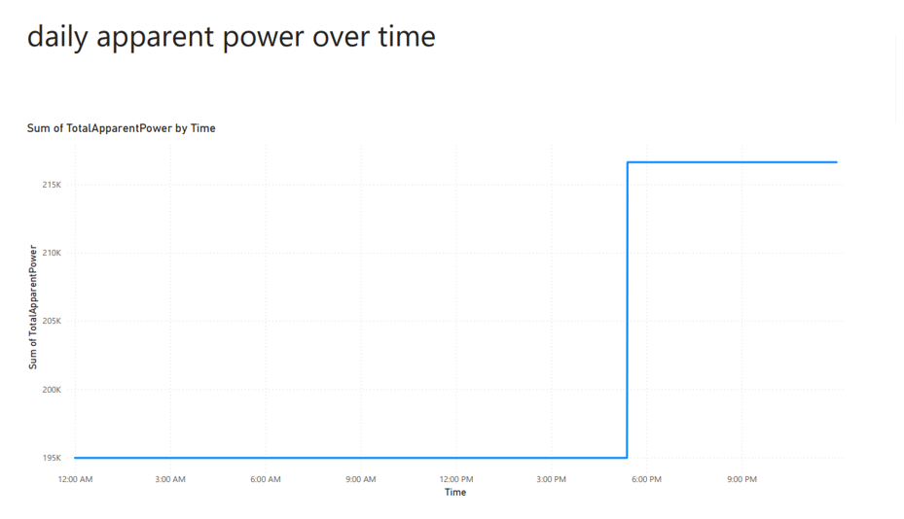
Reporting with Power BI
Daily Apparent Power Over Time
This line chart tracks the total apparent power (measured in thousands of joules) over a 24-hour period. The x-axis shows the time of day, ranging from 12:00 AM to 9:00 PM, and the y-axis represents the sum of apparent power. The power usage shows fluctuations throughout the day, peaking in the late morning and mid-afternoon.

Slide 52
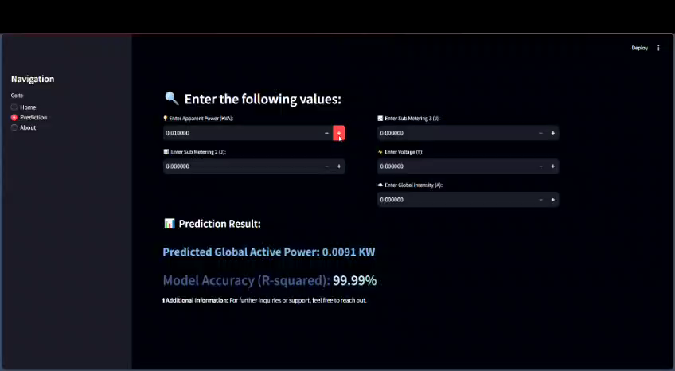
Interface

Slide 53
Conclusion

Slide 54
Real-World Impact
Why is this project important in the real world?
Energy Efficiency for Households: By predicting power consumption, households can make smarter decisions about how and when to use electricity, leading to potential cost savings and reduced waste. This could translate into lower energy bills and a smaller environmental footprint.
Resource Optimization for Energy Providers: Energy providers can use such predictive models to optimize the grid, manage peak loads, and improve energy distribution, ultimately reducing blackouts or wastage during non-peak hours.
Environmental Benefits: On a larger scale, promoting energy efficiency can reduce the strain on power plants, lowering greenhouse gas emissions and supporting sustainability goals. By understanding their consumption patterns, households can reduce over-reliance on fossil fuels and transition toward greener energy sources.

Slide 55
Scalability for Future Applications
The model can be scaled to support advanced smart home systems by integrating real-time data from IoT devices, such as sensors and cameras, to automate appliance control. For example, temperature sensors can adjust heating, or motion sensors can manage lighting. The system can evolve to make intelligent decisions based on user behavior and preferences using machine learning. It can also incorporate cloud services for remote access and control, while edge computing can ensure efficient data processing as more devices are added to the network.

Slide 56
SUMMARY

Slide 57
Summary
“The project successfully analyzed household energy data and built a highly accurate machine learning model to predict power consumption.”
​

Slide 58
Thank you

